Slide 1
CASE STUDY ON SWATCH
Done By
Name -> Vadthya Aniketh
Roll number -> 19EC10069
FOUNDATIONS OF ENTREPRENEURSHIP SPRING 2022

Slide 2
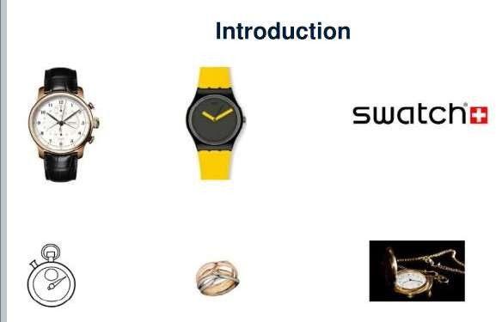

Slide 3
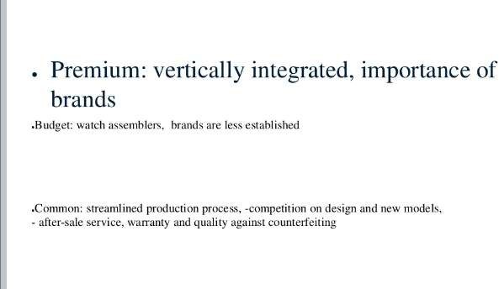

Slide 4
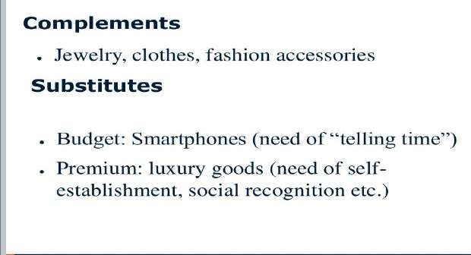

Slide 5
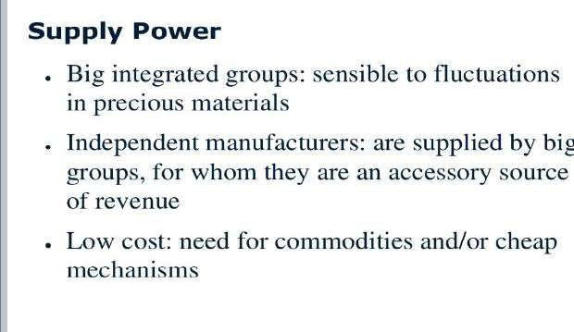

Slide 6
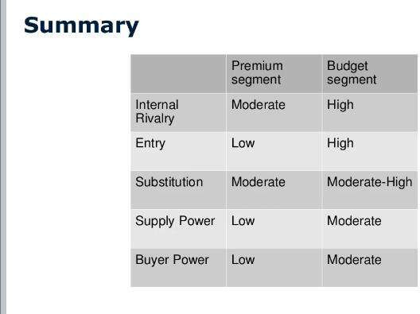

Slide 7
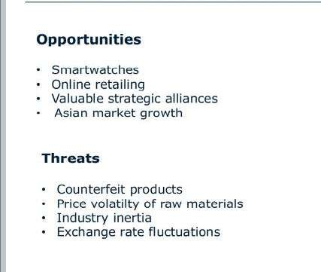

Slide 8


